Slide 1
© 2018 Cengage Learning®. May not be scanned, copied or duplicated, or posted to a publicly accessible website, in whole or in part.

Slide 2
New Products and Innovation
8
© 2018 Cengage Learning.® May not be scanned, copied or duplicated, or posted to a publicly accessible website, in whole or in part.

Slide 3
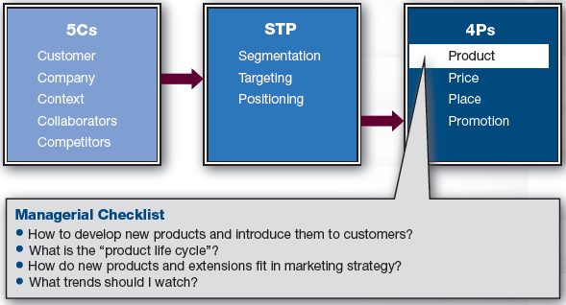
Marketing Framework

Slide 4
Discussion Questions #1
List three new products.
Why do you think companies introduce new products?

Slide 5
Why Improve Products?
For corporate pride
To be consistent with innovative image
To better attract/satisfy customers
To stave off competition
Because the macroenvironment changes
Consumer tastes, natural resources, demographics, cultural changes, etc.

Slide 6
Approaches to Developing New Products
Top-down (inside-out)
Idea generation
Design and development
Commercialization
Customer feedback is sought later in the process; marketing supports product launch
Works well in industries where internal R&D has expertise that end-customers lack
Co-creation (bottom-up or outside-in)
Customer & company co-create products

Slide 7
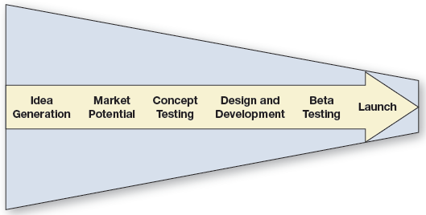
New Product Development Process (slide 1 of 2)

Slide 8
New Product Development Process (slide 2 of 2)
The NPD process is not entirely linear
It is important to continually revisit prior decisions and change when necessary
e.g., A good decision in stage 2 may not be a good decision in later stages
Marketing is involved throughout process
Idea generation, refinement, marketing mix decisions, etc.

Slide 9
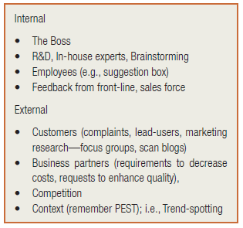
Where Do New Ideas Come From?

Slide 10
Idea Creation & Market Potential (slide 1 of 2)
Idea generation
Brainstorming: “No idea’s a bad idea; let’s get everything up on the white board”
Firms may allocate time for employees to work on pet projects

Slide 11
Idea Creation & Market Potential (slide 2 of 2)
In-house winnowing & refinement
Screen ideas for plausibility using
Internal experts’ knowledge
Marketers’ target knowledge
Management’s company knowledge
Feasibility assessments & business analyses are somewhat fuzzy at this stage

Slide 12
Concept Testing, Design, & Development (slide 1 of 4)
Obtain feedback on plausible ideas
Use marketing research to
Save a company from a bad idea
Yield information to tweak an idea
Encourage pursuit of good idea
Research may include focus groups, online surveys, etc.
Conjoint analysis may also be used to determine trade-offs

Slide 13
Concept Testing, Design, & Development (slide 2 of 4)
Focus groups
2–3 groups (per segment) of 8–10 customers
Usually last 1.5–2 hours
Goal is background information to improve product development or product positioning
Participants give feedback on product concepts

Slide 14
Concept Testing, Design, & Development (slide 3 of 4)
Conjoint procedure
Different combinations of attributes are put together and compared
Customer says which is best, next best, etc.
Use in focus groups, online studies, etc.
Allows marketers to see what attributes are most attractive
e.g., Should a laptop be light, powerful, specific color, and preloaded with software?

Slide 15
Concept Testing, Design, & Development (slide 4 of 4)
Research results are used to develop a prototype
Only one prototype is developed at a time
If the prototype is not successful, another prototype is developed

Slide 16
Beta Testing (slide 1 of 4)
A beta version is made available for trial
Ideal to simulate a real-world purchase
Used to help forecast sales
Customer reactions to marketing materials are also examined
Ad copy, price points, distribution, etc.
Clarifies image of product to customer
Allows company to get feedback

Slide 17
Beta Testing (slide 2 of 4)
Try product in market on a small scale before an expensive full-scale rollout
Area test markets:
Product is made available and ads are run in a few randomly selected metropolitan areas
Sales are observed and compared to sales in control markets
Not as commonly used now because
They are expensive, require setup, tip off competition, and sampled areas may have own “flavors”

Slide 18
Beta Testing (slide 3 of 4)
Electronic test markets are more valid than area test markets
Households within a sample of metropolitan areas are selected: some are designated “test” and some are “control”
Electronic (cable) transmissions are sent to test households, but not sent to the control households
Differences between the test and control households’ purchasing are evaluated

Slide 19
Beta Testing (slide 4 of 4)
Simulated test markets
Popular premarket launch tests
Customers are recruited and given play money to shop in a simulated environment
They can buy the new product and competitors’ products
Advertising materials are available with competitors’ advertising
Marketers record purchases
Customers complete a survey
Data are used as input to forecast sales

Slide 20
Launch (slide 1 of 5)
Forecast sales
If not promising, abort launch
If promising, launch
Forecasts are important to
Accounting and finance for budgeting
Sales force for setting sales goals
Production and logistics for planning equipment, storage, transportation, etc.

Slide 21
Launch (slide 2 of 5)
Forecasting
Goal is to estimate sales potential ($SP), not sales
Determine market potential (MP)
How many units might be sold
Start with secondary data
Census, sales for similar products, etc.
Relevant in-house benchmarking data

Slide 22
Launch (slide 3 of 5)
Forecasting (continued)
Estimate the purchase intention (PI)
Likelihood target will buy the product
Use recent marketing research
e.g., Assume research suggests PI = 0.7
Note: Customers usually overstate PI; estimate ¾ downward P = ¾(0.7)= 0.525

Slide 23
Launch (slide 4 of 5)
Forecasting (continued)
Determine the price (Pr)
Remember economics; PI may increase as Pr decreases
Forecasting equation: $SP = MP × PI × Pr
Remember this number is not profit; it is maximum sales

Slide 24
Launch (slide 5 of 5)
Timing
Process of developing new products can be relatively quick or slow
Delays caused by
Internal activities such as testing
External factors such as regulations
e.g., New pharmaceuticals take years
Promotional efforts are intended to create enough sales to recoup development costs

Slide 25
Discussion Question #2
Outline each likely stage in the new product development process for the introduction of Swiffer Sweeper.

Slide 26
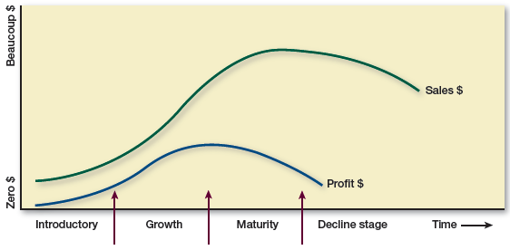
Product Life Cycle (slide 1 of 5)
Describes the evolution and duration of a product in the marketplace
Phases have predictable sales and profits as well as optimal marketing actions

Slide 27
Product Life Cycle (slide 2 of 5)
Market introduction
Low sales
Heavy marketing spending on awareness
Pricing strategies
Penetration: low price
Skimming: high price; recoup R&D costs
Limited distribution

Slide 28
Product Life Cycle (slide 3 of 5)
Market growth
Sales and profits increase
Distribution coverage is greater
Price may increase
Competition
Competitors enter the market and kill each other off or specialize
Product needs competitive advantage
Promotion focuses on product’s superiority

Slide 29
Product Life Cycle (slide 4 of 5)
Market maturity
Industry sales level off; competition is fierce with weaker firms leaving; profits decline
Promotion focuses on product’s superiority and provides a reminder to buy
Product line may be extended and new benefits may be added
Marketing costs increase and price falls due to competition

Slide 30
Product Life Cycle (slide 5 of 5)
Market decline
Sales and profit decline
New products replace older generations
Old products may be
Divested: sold—sell early to get best price
Harvested: support reduced
Rejuvenated: refurbished with new benefits

Slide 31
Discussion Questions #3
Do products have to die?
Are the lengths of product life cycles consistent across products?
Do individual brands have shorter or longer life cycles than product categories?

Slide 32
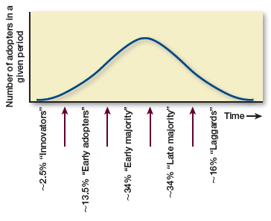
Diffusion of Innovation (slide 1 of 3)
A normal curve is utilized to partition customers into groups to show how new products spread through the marketplace

Slide 33
Diffusion of Innovation (slide 2 of 3)
Innovators: first 3–5%
Like to try new products; willing to take risks
Early adopters: next 10–15%
Even more influential as opinion leaders because the group is bigger
Early majority: next 34%
More risk averse
Waiting to hear about favorable experiences from early adopters

Slide 34
Diffusion of Innovation (slide 3 of 3)
Late majority: next 34%
Even more cautious
Often older and more conservative
Want to buy only proven products
Laggards or non-adopters: next 5–15%
Most risk averse
Skeptical of new products
Stereotypically lower in income
Product category may not be relevant to them

Slide 35
Discussion Question #4
Use the diffusion of innovation model to explain the growth of the smartphone market.

Slide 36
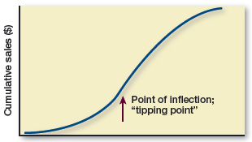
Cumulative Diffusion
Diffusion curve is recast to show cumulative sales
Tipping point: point at which sales rate increases rapidly

Slide 37
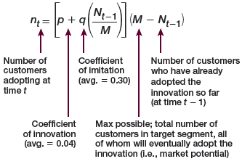
Mathematical Model of Diffusion
Two ways to use diffusion model
Observe early sales data, fit the model, and predict future sales
Plug in past results on similar products and predict future sales

Slide 38
Model of Diffusion
Coefficient of innovation (p)
Likelihood purchase or adoption due to promotion
Increase p by decreasing price earlier
Coefficient of imitation (q)
Likelihood of purchase or adoption due to word-of-mouth information
q is usually bigger than p
Increase q by decreasing price later

Slide 39
New Product Acceptance
Acceptance of new products tends to be higher when the new product:
Has clear relative advantage
Is compatible with customers’ lifestyles
Is not overly complex or has a user-friendly interface
Is easily tried or sampled

Slide 40
New Product Willingness
Companies vary in their willingness to pursue new products
From innovator to reactor
Market pioneers have difficulty with “really new” products
First movers launch “incrementally new” products because there is less risk
Early followers have approximately the same survival risks

Slide 41
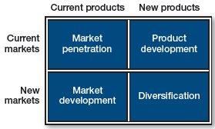
Growth Strategies (slide 1 of 3)

Slide 42
Growth Strategies (slide 2 of 3)
Market penetration
Sell the same products to current customers
New ways to use, better marketing mix, etc.
Easiest strategy
Product development
Sell new or modified products to current customers
Introduce extensions or new variations
Company wants to be innovative

Slide 43
Growth Strategies (slide 3 of 3)
Market development
Sell existing products to new segments
Move global or target different segment
May need to change image, channels, etc.
Diversification
Pursue new markets with new products
Too difficult for most companies due to lack of experience in product and market
Toughest strategy

Slide 44
Trends to Watch
Aging of population
Hispanic population growth
More wealthy Americans
Growing concern for environment and corporate social responsibility
Cultural differences
Role of China and fast-growing economies

Slide 45
Discussion Questions #5
How could firms capitalize on the opportunity presented by the aging population?
Discuss changes in the global economy.

Slide 46
Managerial Recap (slide 1 of 2)
New products are crucial to growth
New product development process
Idea generation to market potential, to concept testing, design and development, then beta testing, and ultimately the launch

Slide 47
Managerial Recap (slide 2 of 2)
Products evolve through a life cycle
Introduction, growth, maturity, and decline
Each stage is recognizable by its sales and profitability and carries 4P recommendations
Models can be used to forecast sales
Marketers should study important trends

